Slide 1

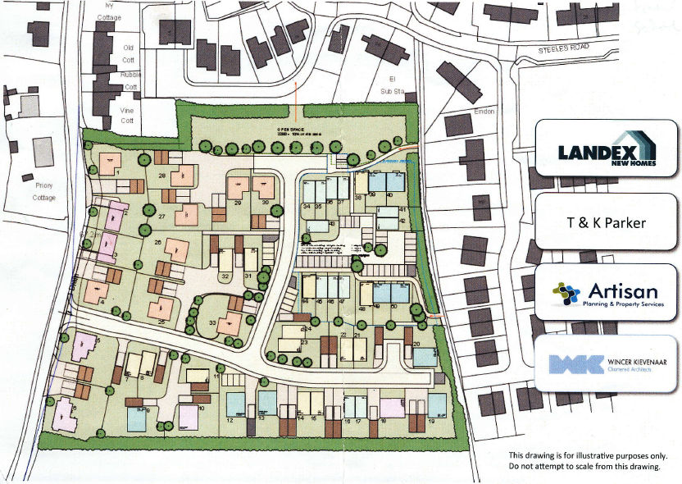
Woolpit Neighbourhood Plan
How it started
Artisan-PPS’s original concept plan for the Green Road development, as distributed in September 2015.
Other developers now include:
Pigeon IMS
Persimmon
Hopkins Homes
New Hall Properties

Slide 2
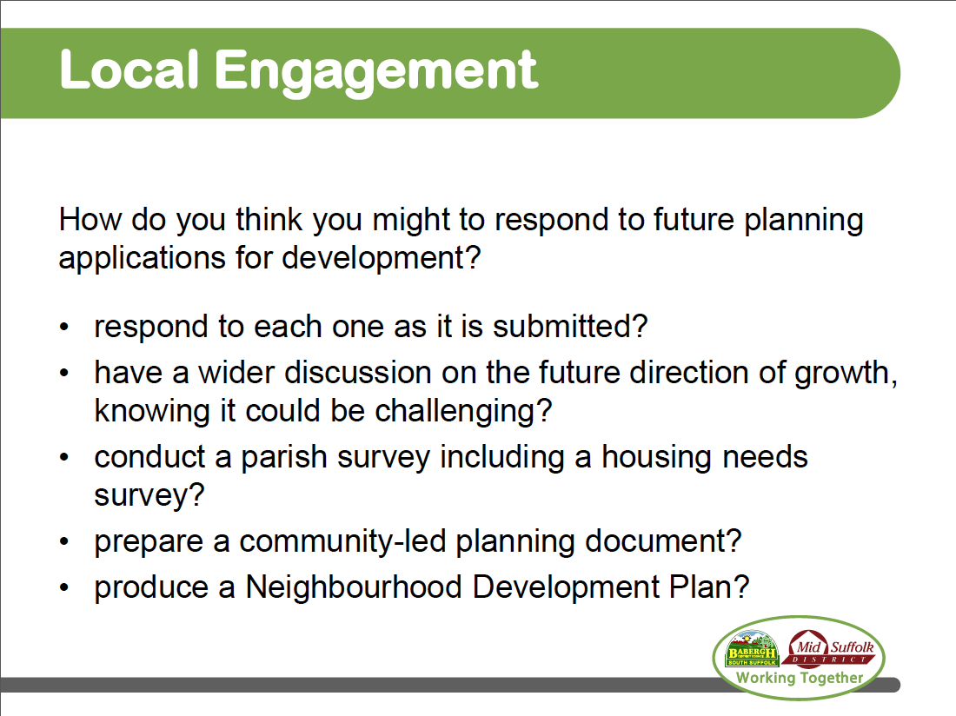
Woolpit Neighbourhood Plan
Community-led planning
These were the options given us by Duncan Merren, from Mid Suffolk District Council.
The Neighbourhood
Plan is the only one which has legal status.

Slide 3
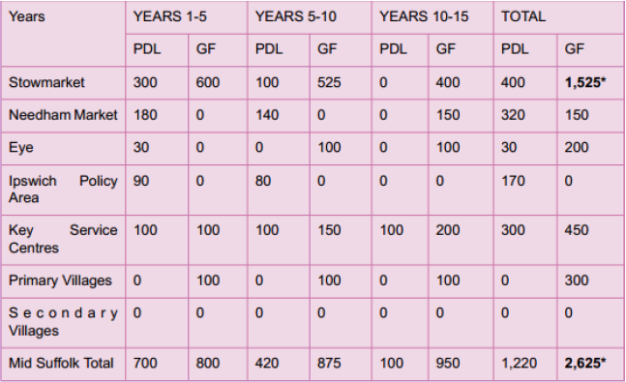
Woolpit Neighbourhood Plan
Housing allocations
Mid Suffolk’s housing plan as published in 2012
PDL – previously developed land
GF - greenfield land

Slide 4
Woolpit Neighbourhood Plan
Proposed housing developments
This table shows the situation in Woolpit, as far as we know at the moment.
Proposed development site | Houses | Application status
Green Road | 50 | Decision pending
Old Stowmarket Road | 120 | Approved
Rags Lane | 60 | None yet
Street Farm | 450 | None yet
Glebe land | 80 | None yet
TOTAL | 760

Slide 5
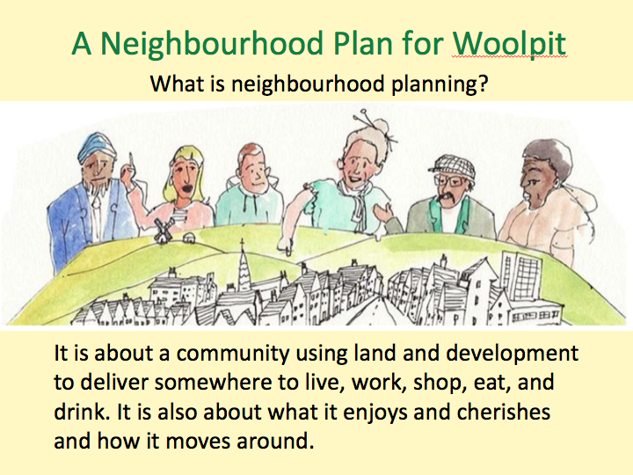
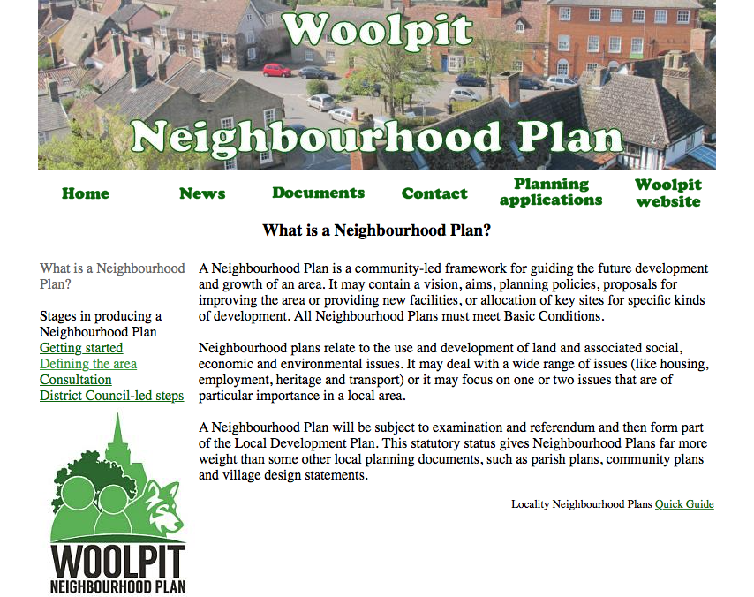
Woolpit Neighbourhood Plan
The Neighbourhood Plan so far
Timescale | Phase | Actions
Dec 2015 -Feb 2016 | Getting started | Raise awareness ✓ Communication / engagement strategy ✓ Form steering group ✓ Identify aims & objectives ✓

Slide 6
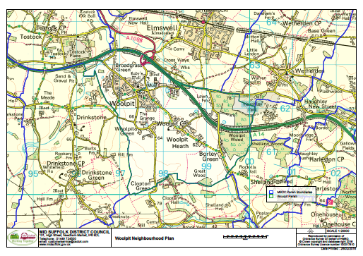
Woolpit Neighbourhood Plan
The Neighbourhood Plan so far
Timescale | Phase | Actions
Mar 2016 -Apr 2016 | MSDC approval | Apply for Neighbourhood Area ✓ MSDC advertise & decide ✓

Slide 7
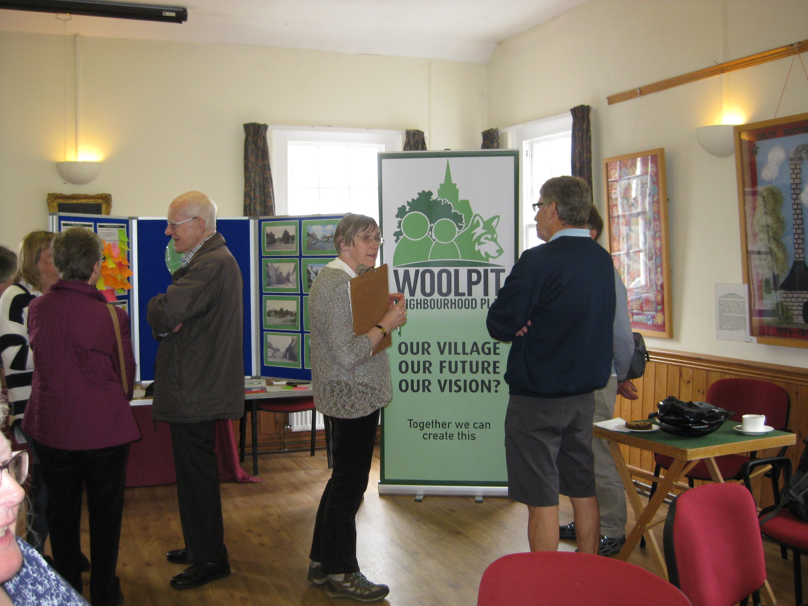
Woolpit Neighbourhood Plan
The Neighbourhood Plan so far
Timescale | Phase | Actions
Mar 2016 -Nov 2016 | Consulting community | Engage and consult residents & stakeholders on emerging issues ...

Slide 8
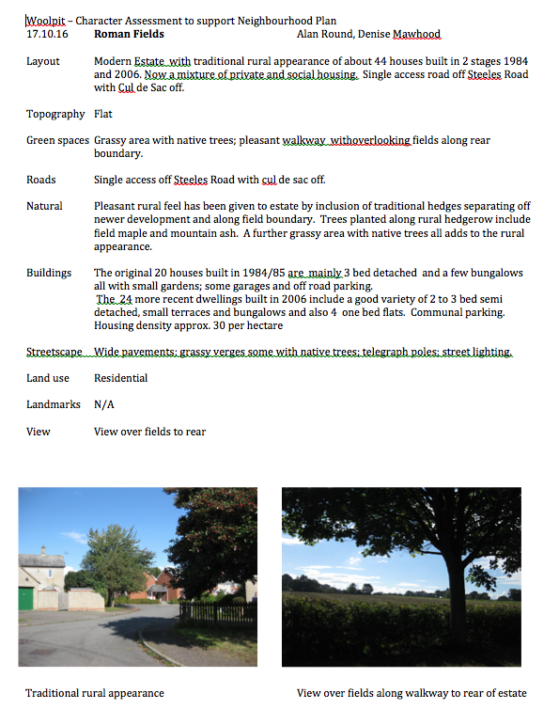

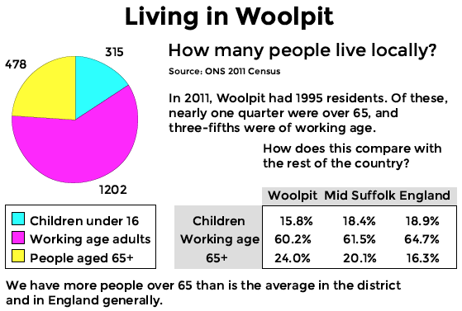
Woolpit Neighbourhood Plan
The Neighbourhood Plan so far
Timescale | Phase | Actions
July 2016 -Dec 2016 | Build evidence base | Existing demographic & socio-economic data ... Neighbourhood character appraisal … SWOT analysis ✓

Slide 9
Woolpit Neighbourhood Plan
Local Authority Liaison Group
Members are Trevor Howard, Vice-chairman of the Parish Council, Jane Storey, Mid Suffolk and County Councillor and Alan Round
As the name suggests – the aim is to provide a liaison between the Steering Group and the local authorities – Mid Suffolk District Council and Suffolk County Council.
Specifically the group has met with Chris Bowden, designated by MSDC as our ‘critical friend’ who can provide help and information to our Steering Group, and Bill Newman, a senior planner at MSDC.
Members have also met with SCC Highways to discuss the implications of any planning applications.

Slide 10
Woolpit Neighbourhood Plan
Local Authority Liaison Group
A further meeting has taken place with other A14 villages that are completing their Neighbourhood plans – Elmswell and Thurston – so that we can work together on some (joint) aspects of our neighbourhood plans. This was attended by Parish Clerks, reresentatives from the parish councils and the local district councilors. Further meetings will explore the wider implications that extra housing will have on local transport infrastructure and school and health provision.
MSDC have held a meeting on ‘Community Engagement’ and invited all Neighbourhood Steering groups to attend. Several members from the Woolpit Group attended. The proposal was to look at housing led growth and its implications.
The Local Authority Liaison Group are in regular dialogue with planners at MSDC and other departments both at MSDC and SCC.

Slide 11
Business Group
Progress
2016

Slide 12
Woolpit Neighbourhood Plan
Business Group Progress 2016
Businesses are stakeholders in Woolpit, therefore here is our consultation with them so far:
February: Contacted as many businesses as possible
April: Drafted preliminary business questionnaire
June: Gained approval of steering group to conduct business interviews
July to present: Face to face interviews with a selection of businesses

Slide 13
Woolpit Neighbourhood Plan
Business Group Progress 2016
23 Businesses have been interviewed so far (This is an ongoing process)
Approximately half cited the A14 as a key reason for their current location in Woolpit – allowing access to Elmswell train station and customers in Bury St Edmunds & Ipswich
All intend to remain in Woolpit if possible
Together the businesses interviewed so far offer over 450 jobs
Businesses and their staff use village amenities as follows:

Slide 14
Woolpit Neighbourhood Plan
Business Group Results So Far…

Slide 15
Woolpit Neighbourhood Plan
Business Group Progress 2016
Suggestions for Improvements that have come from Business interviews:
Extend parking facilities in center of village
Create a cycle route to Elmswell station
More frequent bus service
Improve road network around current ‘hot-spot’ areas
Most business are in favour of green energy projects

Slide 17
Woolpit Neighbourhood Plan
Woolpit Character Assessment
What is it?
• It describes the distinct appearance and feel of a village and the area around it.
• It describes what makes Woolpit unique.
• When complete it will inform various policies in the final Neighbourhood Plan

Slide 18
Woolpit Neighbourhood Plan
Woolpit Character Assessment
Why do we need it?
• So that any Planning proposals take the distinctive character of Woolpit into account.
• So that developers and architects have an understanding of the village setting so designs are appropriate.
• It means we can be supportive of new development if it can complement and even enhance the local character of the village.

Slide 19
Woolpit Neighbourhood Plan
Woolpit Character Assessment
How do we do it?
Step 1
• Using local knowledge divide the settlement area of Woolpit into 3 broad character areas:
Woolpit West: built mainly between 1970 - 1990
Woolpit Central: mainly historic buildings and conservation area
Woolpit East: originally built as social housing
• Using maps divide the surrounding area into 5 Landscape Areas stretching from the village to the Parish boundary.
Notes:
Template slide for presentation. Text fonts: WOOLPIT NEIGHBOURHOOD PLAN is Langon 14pt, colour Pantone 7742 C; Slide title is Montserrat Bold 28pt, colour Pantone 7738 C; Body text is Montserrat Regular 20pt, colour Pantone 7738 C (you can use Pantone 7742 or black if you prefer, but don’t use smaller than 20pt).

Slide 20
Woolpit Neighbourhood Plan
Woolpit Character Assessment
How do we do it?
Step 2
• Set up a proforma for our assessment based on a Tool Kit provided by the District Council.
• In small groups walk around Woolpit, street by street with clipboard and make notes on what we see that makes up the particular character of that area.
• Take photograph of significant views and special features.
• Share our notes and photos get feedback from others to check we have an accurate and balanced record.

Slide 21
Woolpit Neighbourhood Plan
Next steps
Timescale | Phase | Actions
Dec 2016 -Mar 2017 | Survey the community | Analyse evidence to identify gaps Scope and focus – devise questions Conduct survey Analyse questionnaire responses
Apr 2017 –Jun 2017 | Draft the plan | Scope & content Define vision and aims Identify key themes and objectives Examine development options and consult landowners / developers Seek advice from MSDC on statutory requirements Draft policies & guidance

Slide 22
Woolpit Neighbourhood Plan
Any questions?
Thank you for listening!

