Slide 1
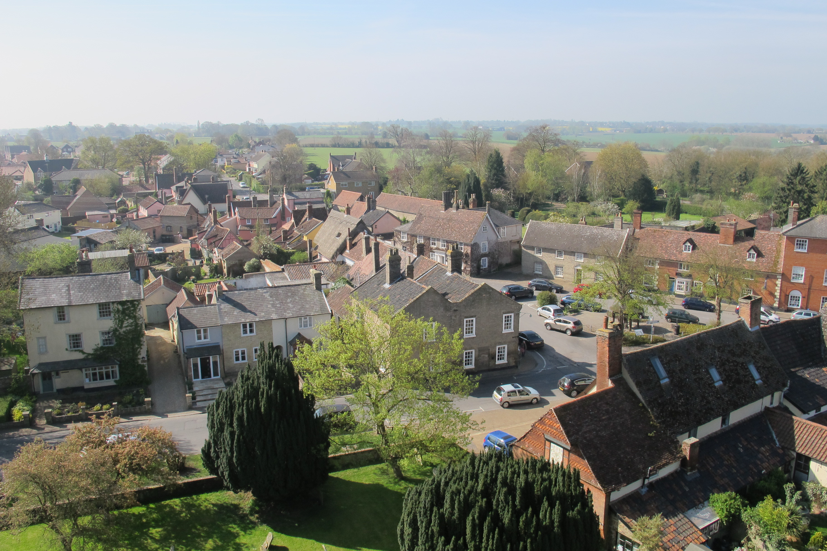
A Neighbourhood Plan for Woolpit

Slide 2
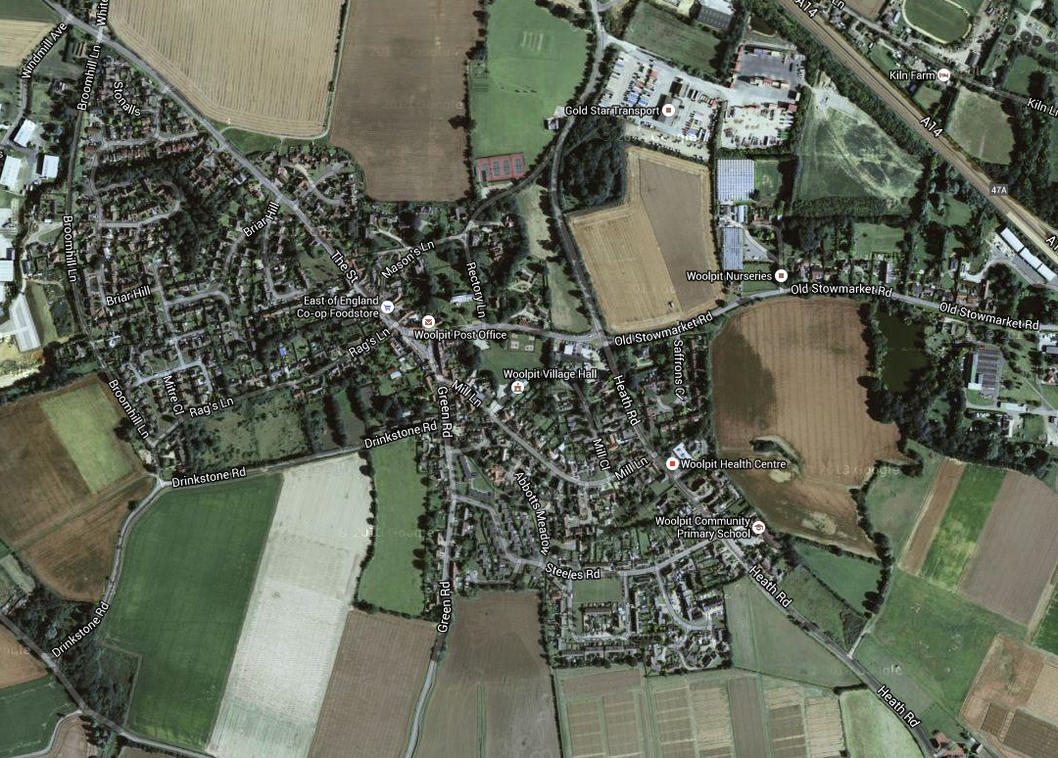
A Neighbourhood Plan for Woolpit
Housebuilding in Woolpit since 1990
Wrights Way
Hay Barn Meadow
Old Stowmarket Road
Cow Fair
Built
Abbotts Meadow
Cornmill Green
Building
Proposed
Roman Fields
Green Road
Greencroft

Slide 3
A Neighbourhood Plan for Woolpit
Why the need for more housing?
National housing shortage
Pressure for development in Mid Suffolk
Mould proposals to achieve local aims
Woolpit housing survey

Slide 4
A Neighbourhood Plan for Woolpit
National planning policy framework
Sustainable development
Community involvement
Prior consultation by developers
Currently no Mid Suffolk plan
Need for a Neighbourhood Plan

Slide 5
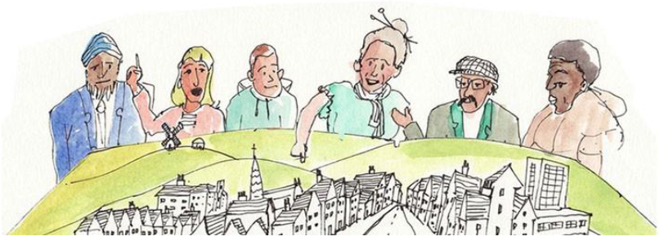
A Neighbourhood Plan for Woolpit
What is neighbourhood planning?
It is about a community using land and development to deliver somewhere to live, work, shop, eat, and drink. It is also about what it enjoys and cherishes and how it moves around.

Slide 6
A Neighbourhood Plan for Woolpit
What is a Neighbourhood Plan?
Used to decide what type of development takes place, and where
About use and development of land but can include parish projects
Requires a robust evidence base to support policies and proposals
When complete, becomes part of the Local Plan framework and has legal weight in decision-making

Slide 7
A Neighbourhood Plan for Woolpit
Limitations on a Neighbourhood Plan
Cannot stop growth or limit development to less than the Local Plan
Must conform to national and district planning policy
Must contribute to sustainable development

Slide 8

A Neighbourhood Plan for Woolpit
Neighbourhood planning: the roadmap
There are 7 stages
District Council will help us to produce the plan
Parish Council has a role to play, but can delegate the business to a Working Group
We must involve everyone in Woolpit by seeking their ideas and opinions

Slide 9
A Neighbourhood Plan for Woolpit
Pros and cons
Benefits: influence where future housing and other developments in Woolpit, helping to decide
where they should go
what type of houses and facilities we need
how to manage traffic and access within the village (eg parking, cycle paths)
Otherwise: limited say on where development goes, and how much there is.
no District Plan at present
no local restrictions on developers
A Neighbourhood Plan would have legal standing.

Slide 10

A Neighbourhood Plan for Woolpit

